Slide 1
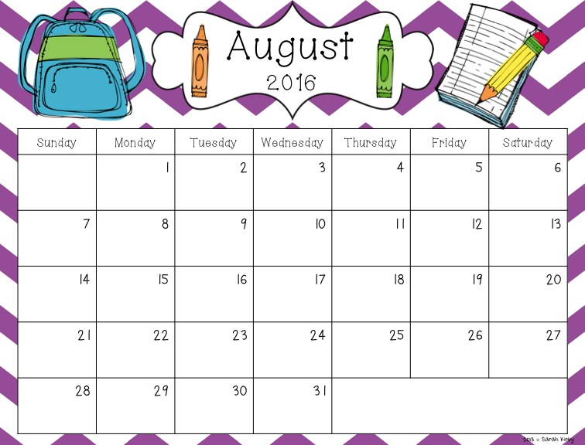



Kevin Q’s
Birthday!
Ms. Luvia’s Birthday!
Jacob’s
Birthday!
Ms. Yarisa’s
Birthday!
Mr. Roger
Birthday!
Ms. Iris’
Birthday!
New Parent
Orientation
Parent
Orientation
First Day of
School
Ms. Christy’s
Birthday!
(School Wide Assessments)

Slide 2
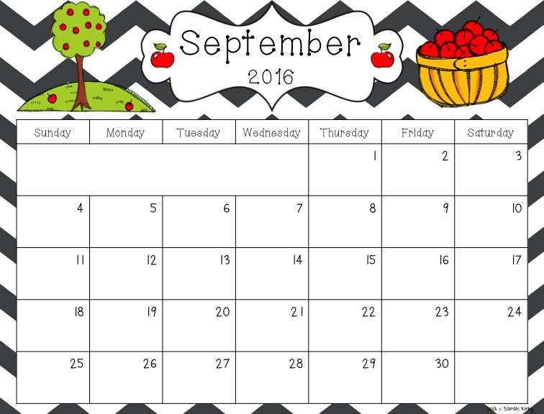

(School Wide Assessments)
Steven Arcia’s Birthday!
Julian Fonseca’s
Birthday!
Ms. Mari &
Juan Ricart’s
Birthday!
Labor Day-
No School
(School Wide Assessments)
Adrian J.’s
Birthday!
Jesse Z.’s
Birthday!
Lucas P. &
Samir L.’s Birthday!
9/11 Memorial
Day
Ms. Angie’s
Birthday!
First Day
of Fall
Ms. Elias’
Birthday!
Teacher Planning
Day- No School

Slide 3
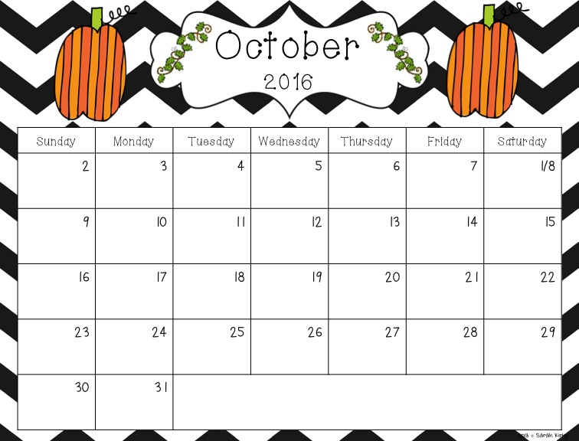




Lucas Garzon’s
Birthday!
Ms. Liz, Joshua, &
Daniel Sanchez’s
Birthday!
10/1 Francesca’s
Birthday!
Ms. Mily’s
Birthday!
Hispanic Heritage
Celebration
Columbus Day
Cristian V.’s
Birthday!
Brandon’s
Birthday!
Marcel’s
Birthday!
Ms. Jennie’s
Birthday!
End of Grading Period
Reece & Brady’s
Birthday!
Happy
Halloween!

Slide 4
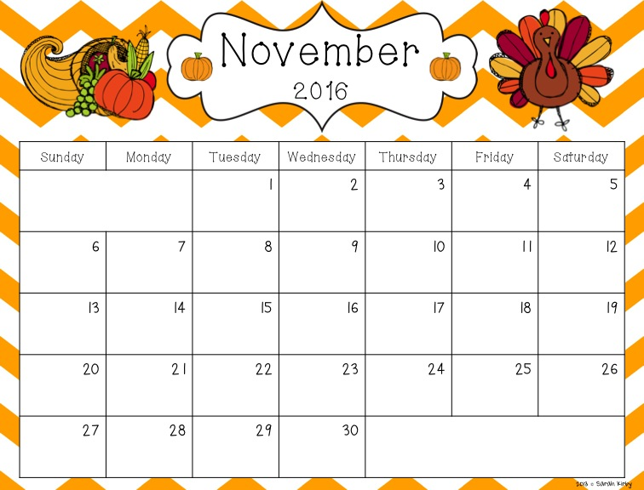



Ms. Elvira’s
Birthday!
Matthew Rosello’s
Birthday!
Skyler’s
Birthday!
Election Day
No School
Devin & Reagan’s
Birthday!
Marideth’s
Birthday!
Izaak’s
Birthday!
Vincent’s
Birthday!
Daniel Felipe’s
Birthday!
Ms. Garcia’s
Birthday!
Thanksgiving
Feast
Teacher Planning
Day- No School
Happy Thanksgiving!
No School
Mr. Jay’s
Birthday!
Ms. Olga’s
Birthday!

Slide 5
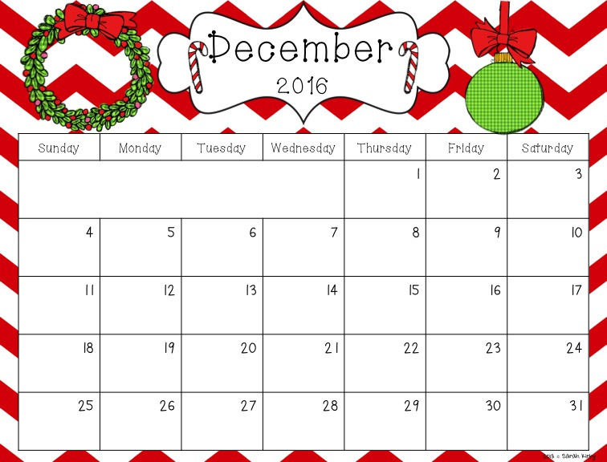


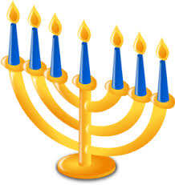

Tommy Gross’
Birthday!
* Return to school Monday, Jan. 9, 2017
Matthew F. & Alejandro’s Birthday!
Daniella Puig’s
Birthday!
Kristopher A.’s
Birthday!
Coach OD’s
Birthday!
Sofia Pinero’s
Birthday!
Melissa Guerrero’s
Birthday!
Art Show
Joseph’s
Birthday!
Christopher F.’s
Birthday!
Rachel C.’s
Birthday!
First Day of
Winter
Teacher Planning
Day- No School
Christmas Eve
Hanukkah Begins
Nicholas N.’s
Birthday!
Ms. Jackie’s
Birthday!
Sebastian
Botero’s Birthday!
Kaylee’s
Birthday!
Ms. Ariana’s
Birthday!
Kwanzaa Begins
………………..Winter Break………………..
Christmas Day
New Years Eve

Slide 6
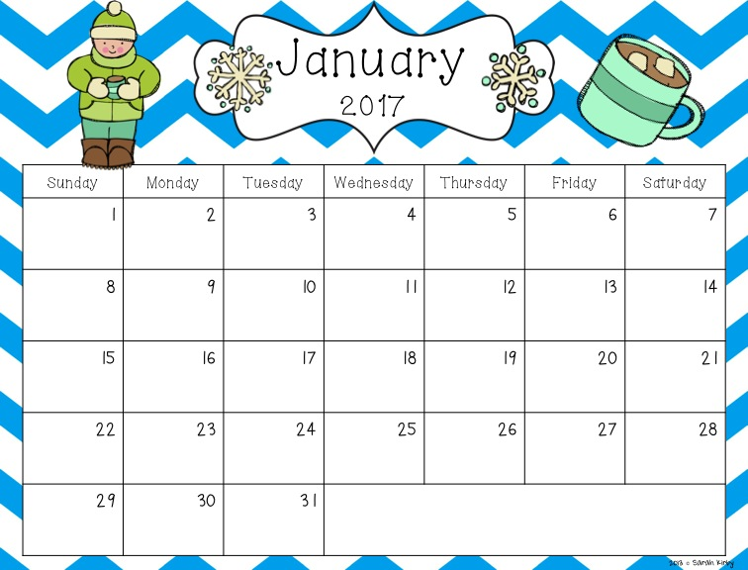
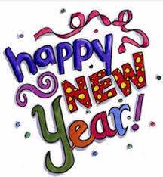
Max F. &
Ms. Molina’s
Birthday!
………………..Winter Break………………..
Victoria’s
Birthday!
Return Back
to School
Jose Crespo’s
Birthday!
Justin Valdes’
Birthday!
Ms. Johana’s
Birthday!
MLK Day-
No School
End of Grading Period
Ms. Adriana’s
Birthday!
Vitali’s
Birthday!
Teacher Planning
Day- No School
Ms. Bianca’s
Birthday!

Slide 7
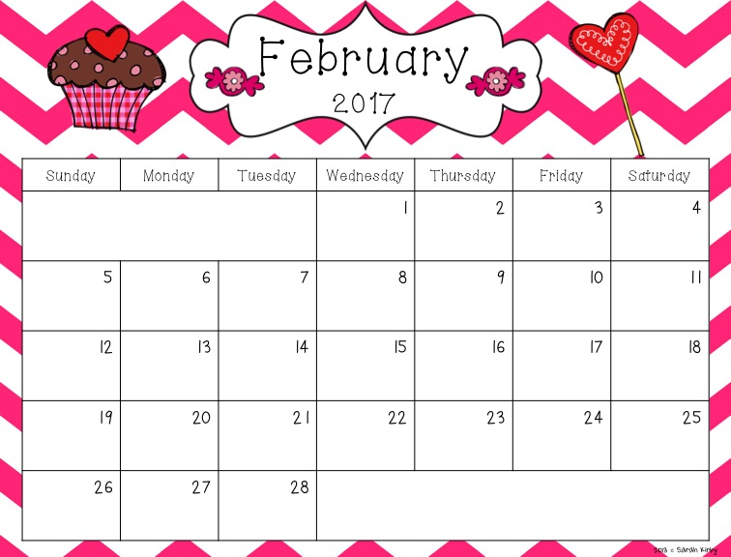




100th Day of
School
Groundhog Day
Valentine’s Day
Dance
Cristian Leiva’s
Birthday!
Mr. Dennis &
Sebastian Aleman’s
Birthday!

Slide 8
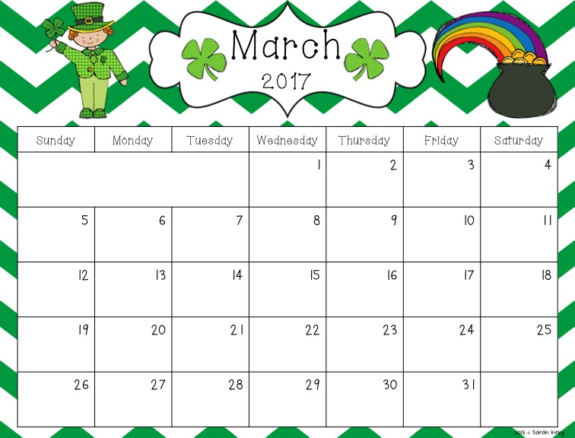
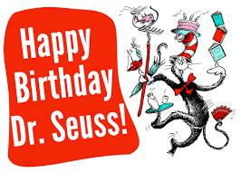


Adrian C &
Ms. Bernie’s Birthday!
Gabriel & Isabella’s
Birthday!
Ms. Jenny’s
Birthday!
Kenny’s
Birthday!
Primary/ Inter.
Field Day
Intermediate
Field Day
STRIDE/PACE
Field Day
First Day of
Spring
Teacher Planning
Day- No School
End of Grading Period
Ms. Ana’s
Birthday!

Slide 9
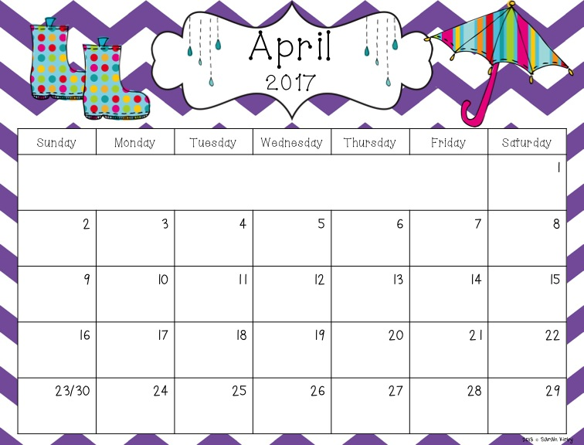
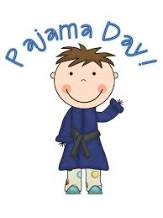





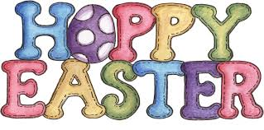
April Fools Day
Sean Valdes’
Birthday!
Yasar’s
Birthday!
Adam H.’s
Birthday!
Teacher Planning
Day- No School
Ms. Hernandez’s
Birthday!
Noah’s
Birthday!
………………..Spring Break………………..
Good Friday
Julian Puig’s
Birthday!
Adam G.’s
Birthday!
CJ’s
Birthday!
4/23 Miguel Lopez’s
Birthday!
Milo & Carolina’s
Birthday!
Fiona’s
Birthday!
Secretary’s Day

Slide 10
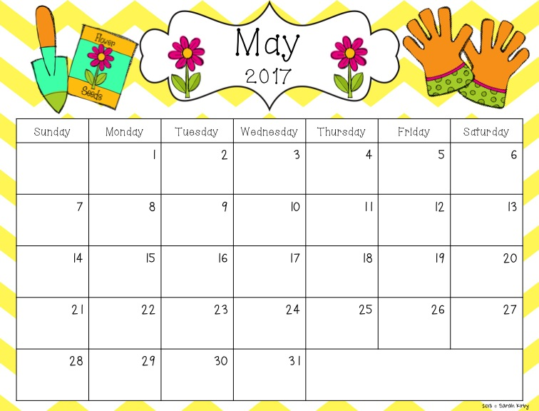



Benjamin Dietz’s
Birthday!
Cinco De Mayo
Daniel Rosario’s
Birthday!
Anthony Aleman’s
Birthday!
Mother’s Day
Breakfast
Luis Gonzalez’s
Birthday!
Sofia Peart’s
Birthday!
(School Wide Assessments)
Madison D.’s
Birthday!
(School Wide Assessments)
Ms. Yvonne’s
Birthday!
Mr. Charles’
Birthday!
Memorial Day-
No School

Slide 11
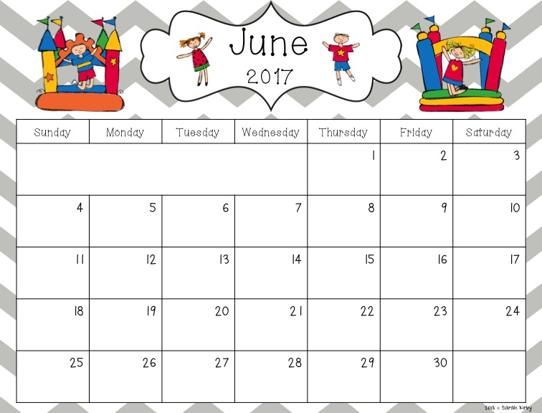

Sophia Mahecha’s
Birthday!
Last Day of
School
End of Grading Period
Alia Luna & Shaya’s
Birthday!
Chris Alvarez’s
Birthday!
Ms. Michelle’s
Birthday!

